Slide 1
Computer Vision
Joe Webb, PhD
jlwebb@attain.com
joelwebb@maximus.com
03/13/2021

Slide 2
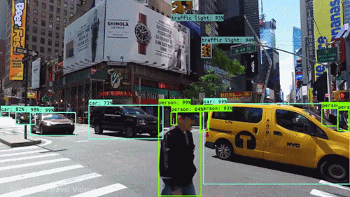
Today’s Outline
Introduction
Machine Learning Background
How Computer Vision Works
Planning a Computer Vision Project
Computer Vision Example Use Cases
Questions

Slide 3
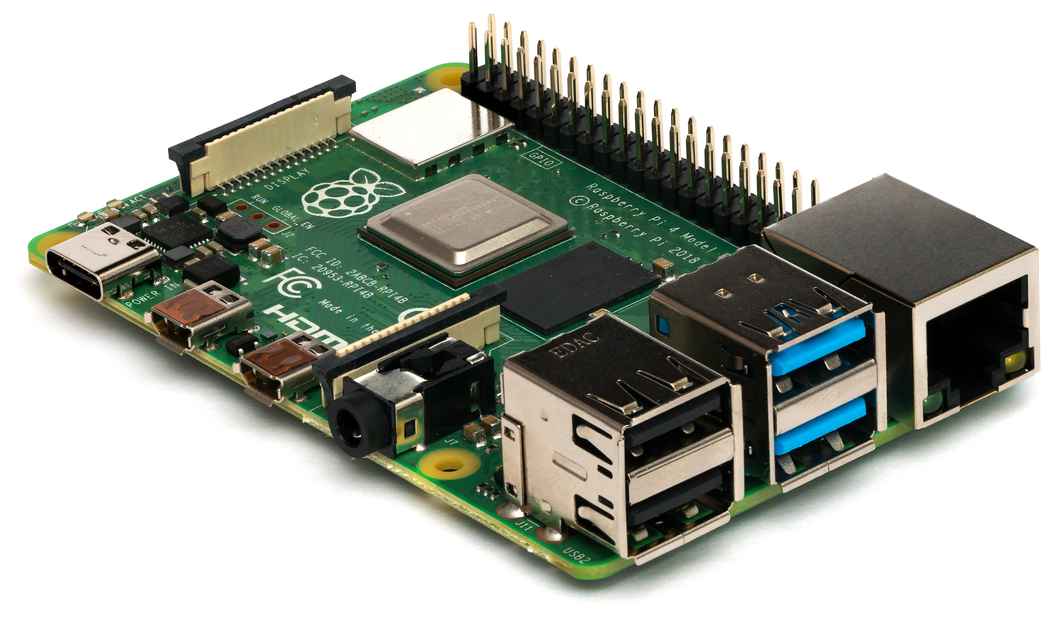
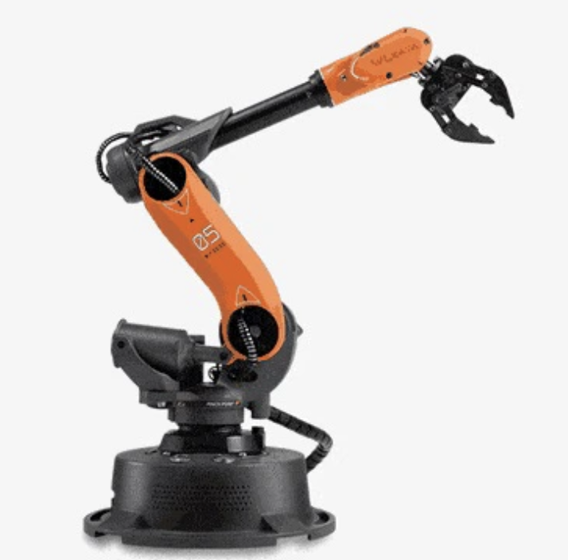
Introduction
Research Scientist at Mayo Clinic
PhD in Biochemistry/Bioinformatics
Data Management Consulting
Fintech Software Development
Machine Learning Consulting for Pharmaceutical/Vaccine Development

Slide 4
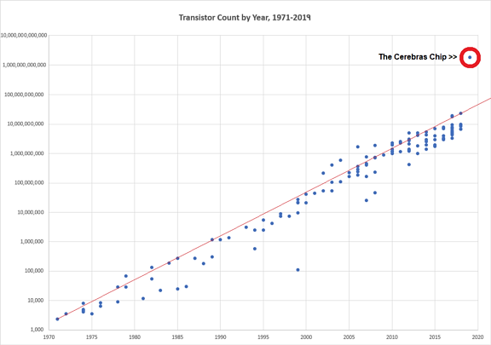
Compute Power Over Time
Transistor Count by Year, 1971 - 2019
10 Trillion
1 Trillion
100 Billion
Moore’s Law
10 Billion
1 Billion
Transistors Per Chip
100 Million
10 Million
1 Million
100,000
10,000
1000
1970
1975
1980
1985
1990
1995
2000
2005
2010
2015
2019
Year
https://cerebras.net/product/

Slide 5
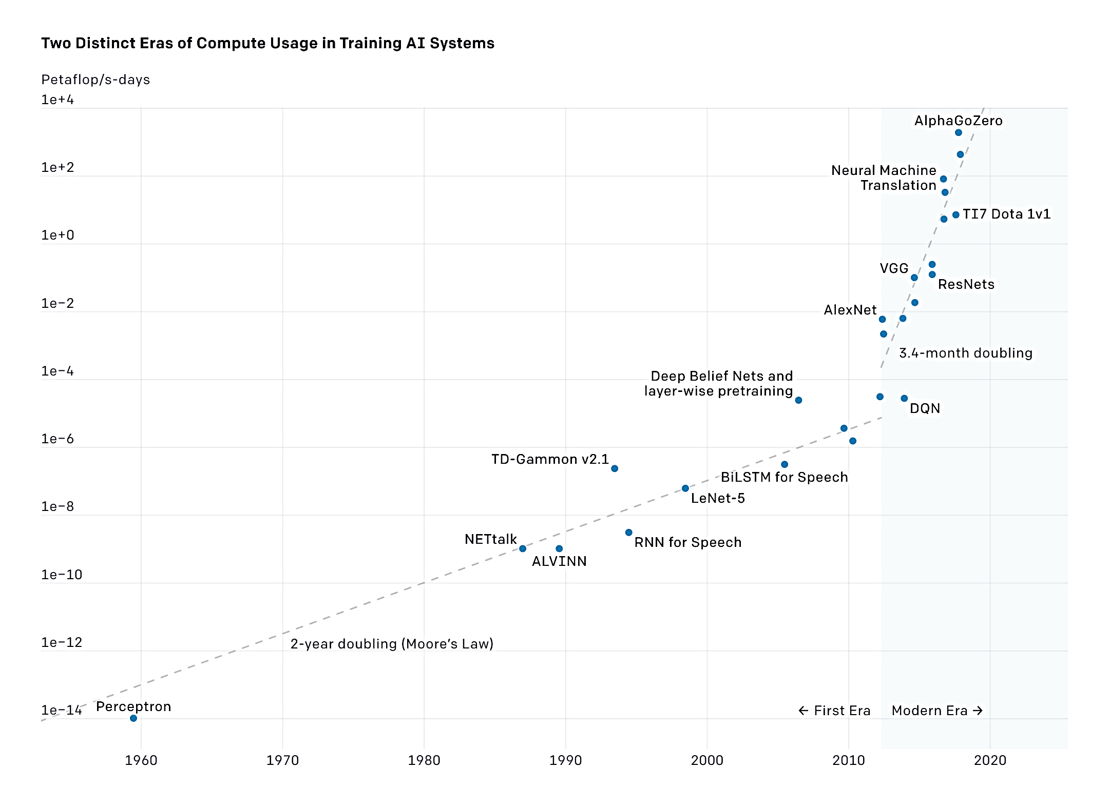
Machine Learning & Moore’s Law
AI System Training Power
10,000
100
Computing power used in AI is doubling every 3.4 months!
1
1e-2
Petaflops / Second
https://openai.com/blog/ai-and-compute/
1e-4
1e-6
1e-8
AI in 2019 needed 44 times less computing power than 2012.
1e-10
1e-12
https://openai.com/blog/ai-and-efficiency/
1e-14
1960
1970
1980
1990
2000
2010
2020
Year

Slide 6
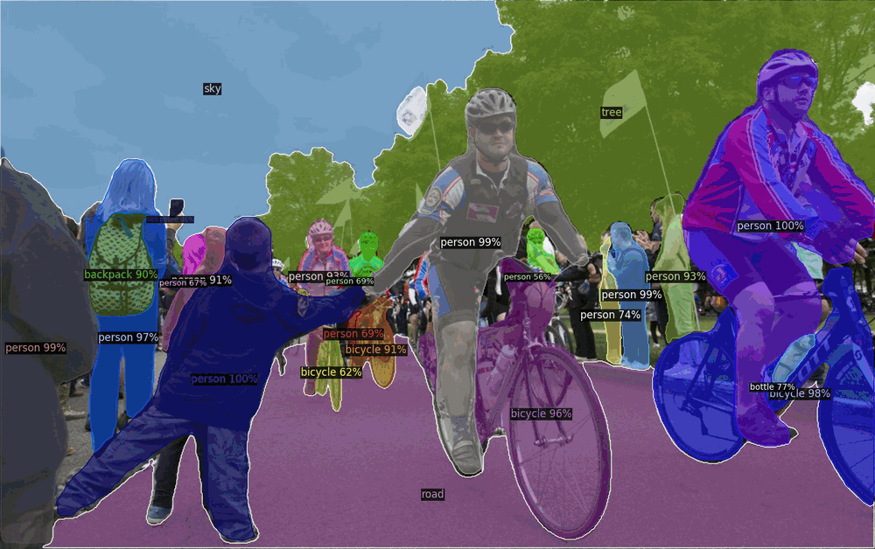
Machine Learning & Computer Vision
Machine Learning is a field of science that focuses on the design and implementation of software that enables computer programs to learn through data or examples.
Computer Vision is a sub field of machine learning focused on enabling computers to analyze digital images or videos. Computer Vision seeks to automate visual tasks that humans can do.
Example of open-source image recognition tasks: Object detection, image segmentation, pose estimation, and instance segmentation

Slide 7
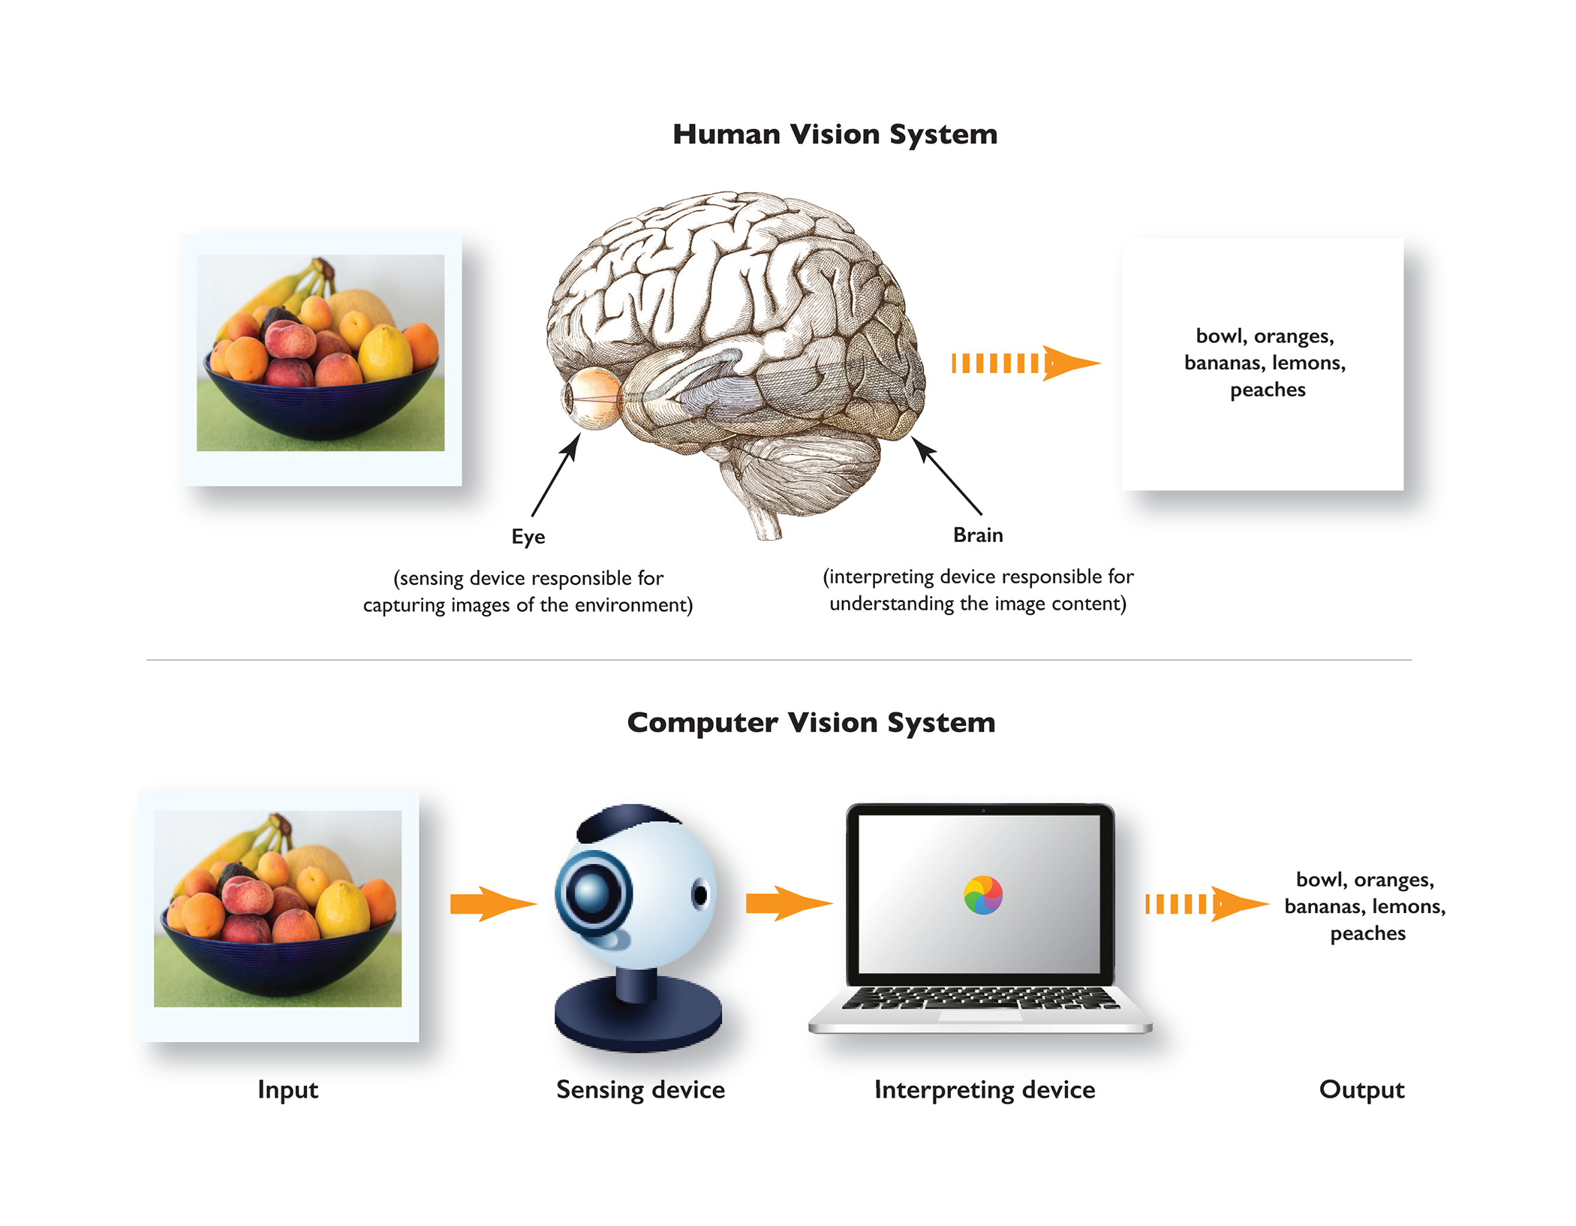
Computer Vision
Computer Vision: Analysis of visual data (images/videos) to detect objects, classify pictures and extract insights
https://www.manning.com/books/grokking-machine-learning

Slide 8
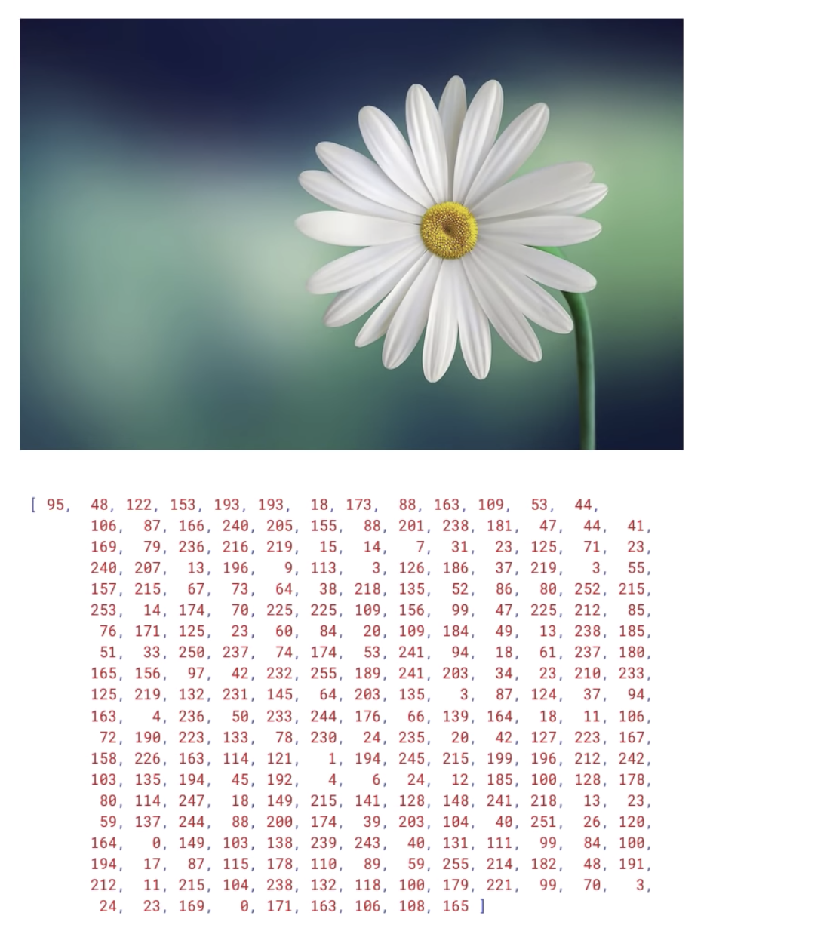
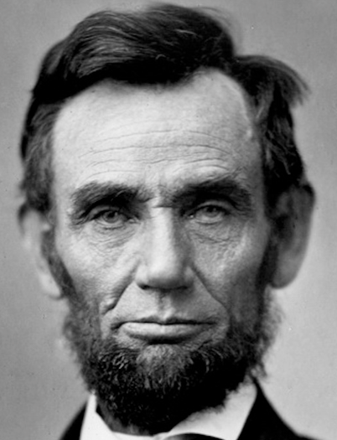
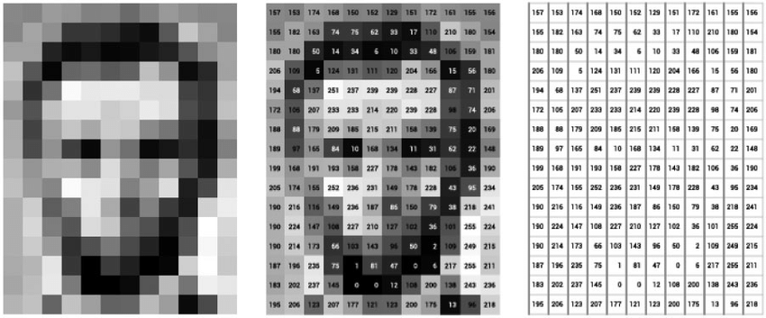
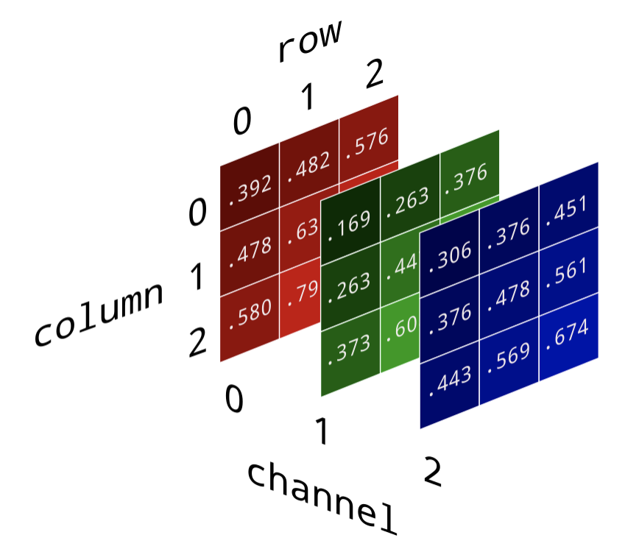
How Computers “See” Images

Slide 9
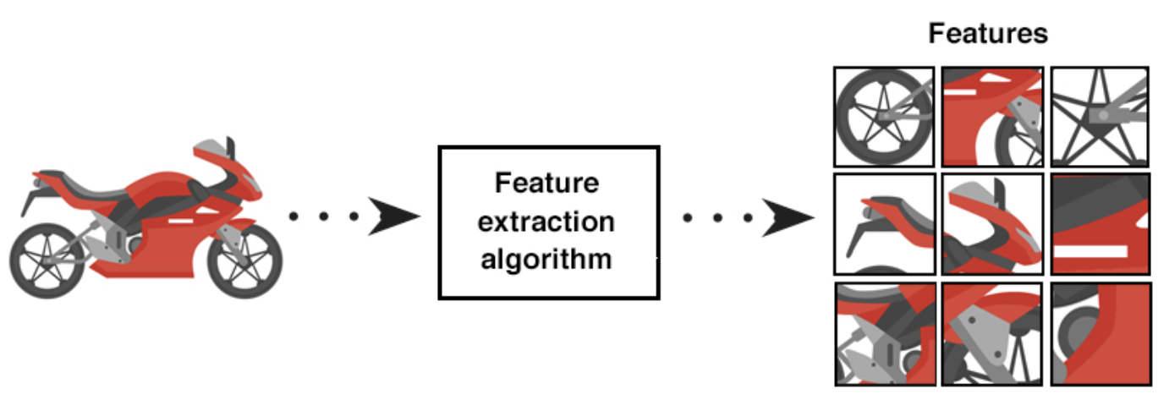
Image Features

Slide 10
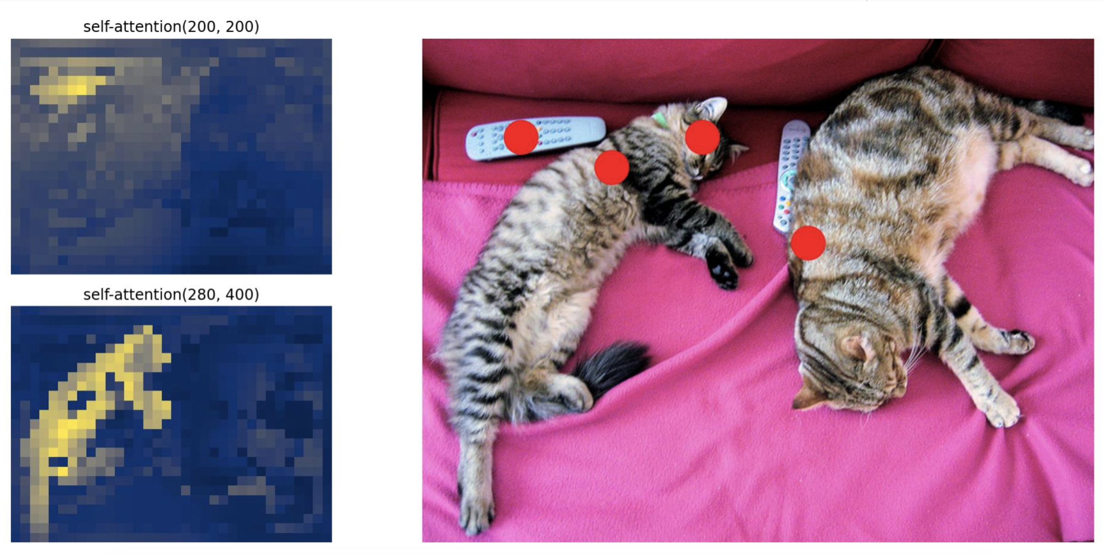
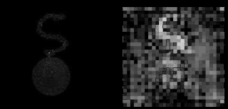
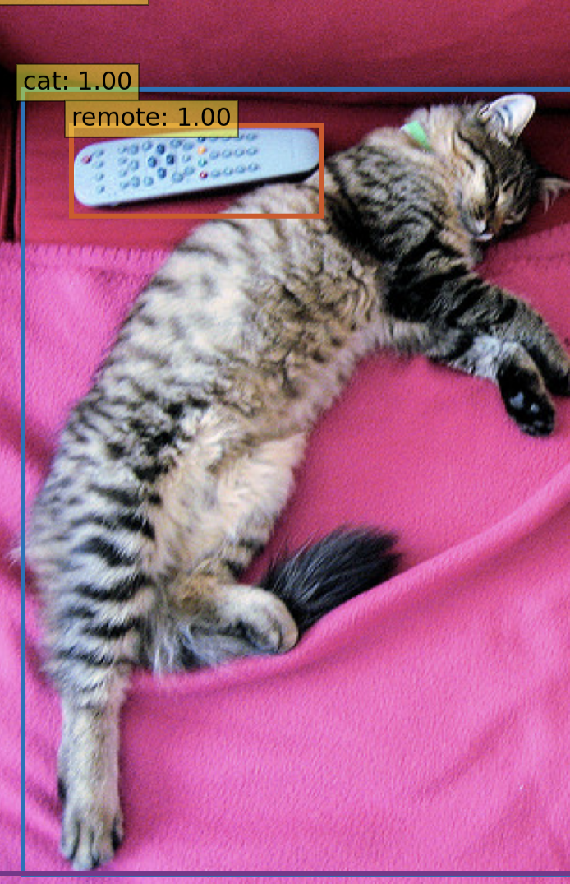
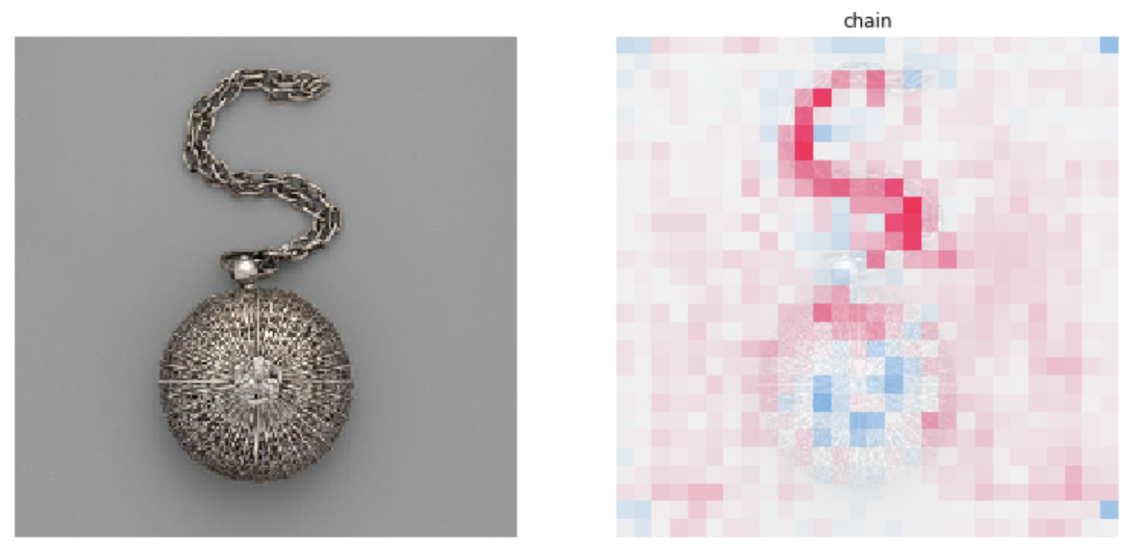
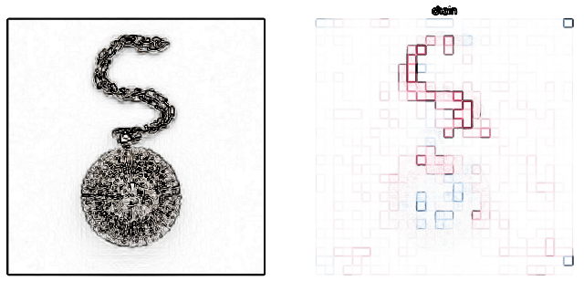
Computer Vision Features
Remote
Cat
https://manningbooks.medium.com/the-computer-vision-pipeline-part-4-feature-extraction-6343ef063588

Slide 11
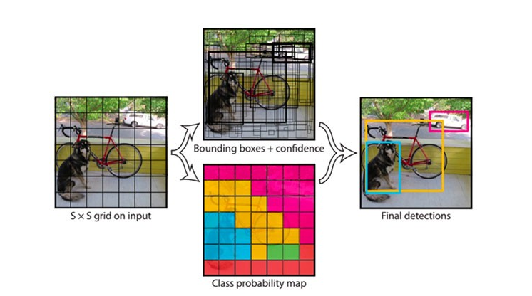
Localization Example

Slide 12

Convolutional Neural Network Classification
https://data-flair.training/blogs/cats-dogs-classification-deep-learning-project-beginners/

Slide 13

How Do I Start Applying Computer Vision?
Plan
Create a walkthrough of current challenges and potential projects to prioritize for automation.
Prepare
After selecting a task, create a detailed step-by-step protocol of the process to understand all available data & tasks.
Analyze
Run tools to examine the results, evaluate outcomes and reassess the plan for improvements.
Connect
Connect the necessary personnel with resources to gather data and add relevant domain expertise.

Slide 14
Computer Vision Process

Slide 15
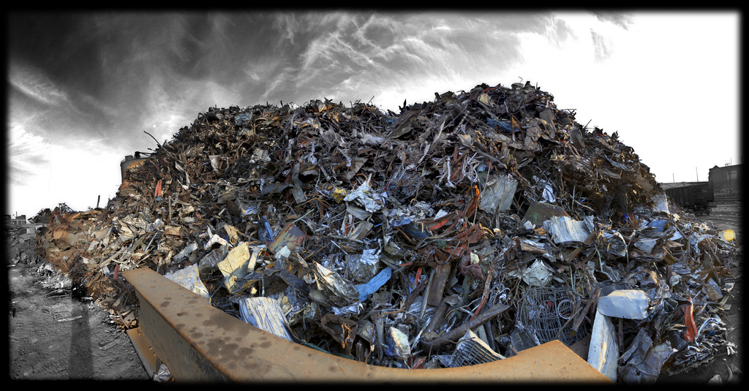
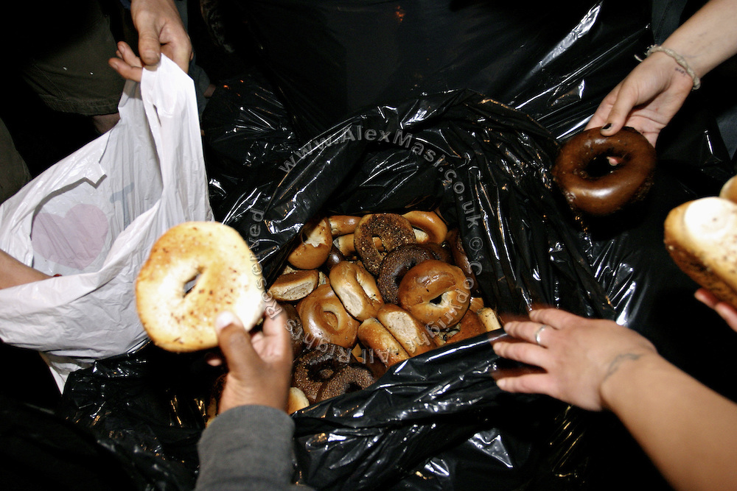
Step 1: Collecting Data
Lots of Data!
Still Fresh!

Slide 16
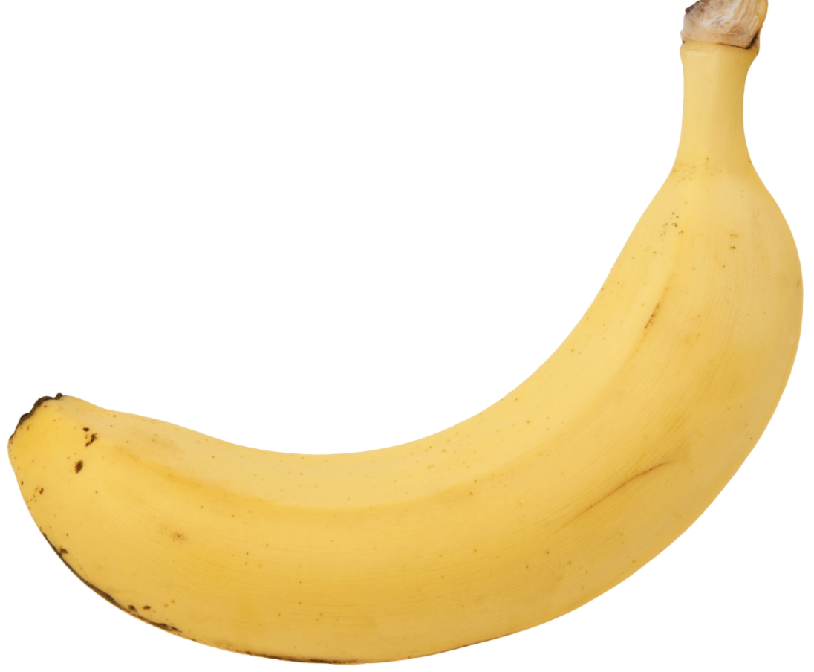
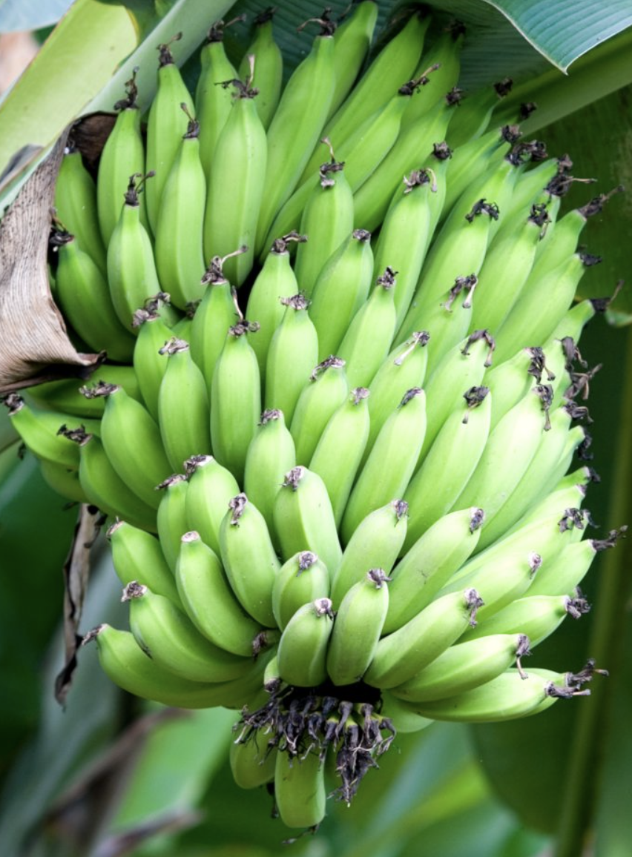
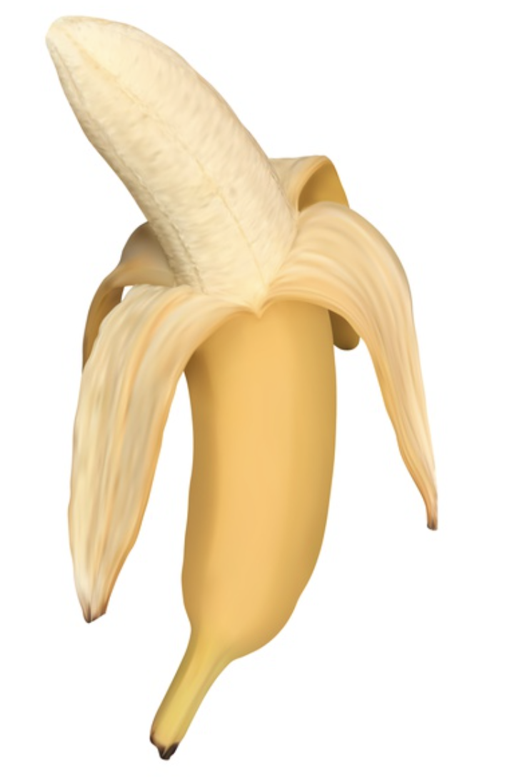

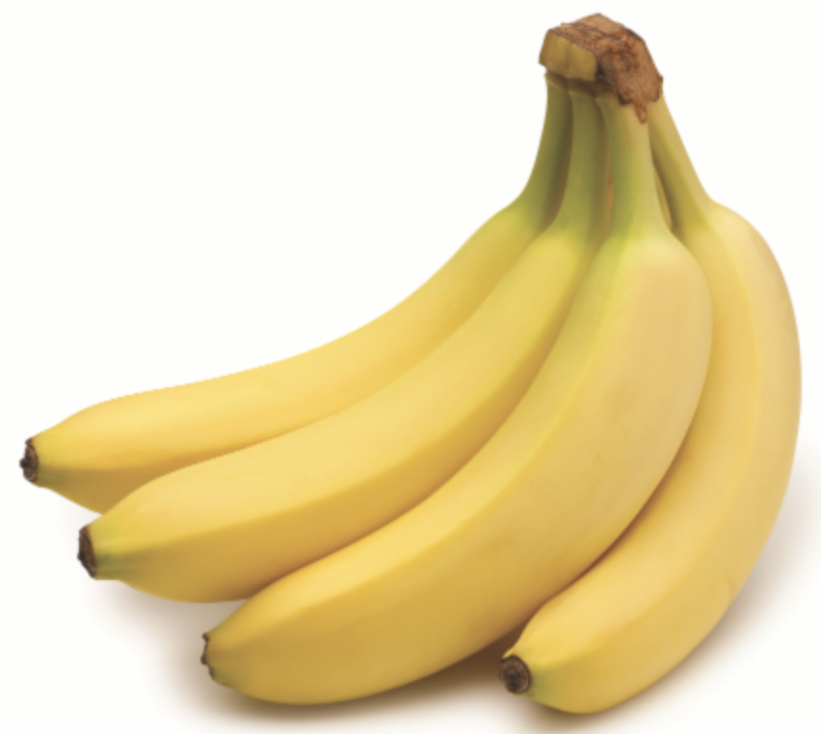
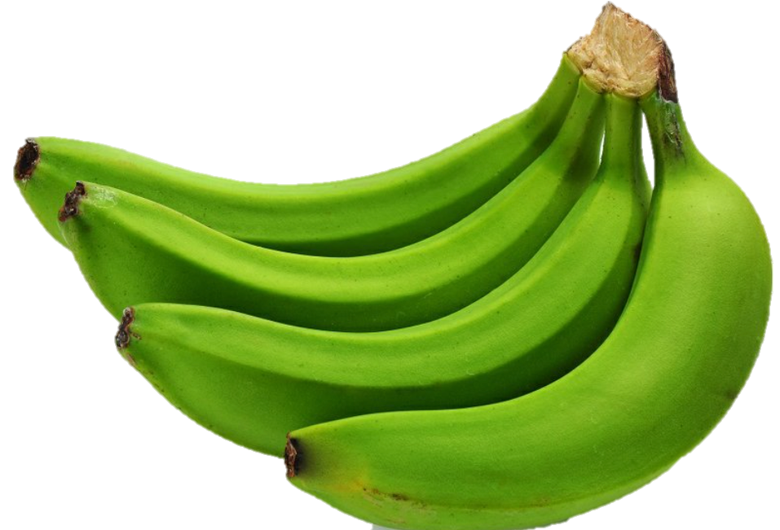
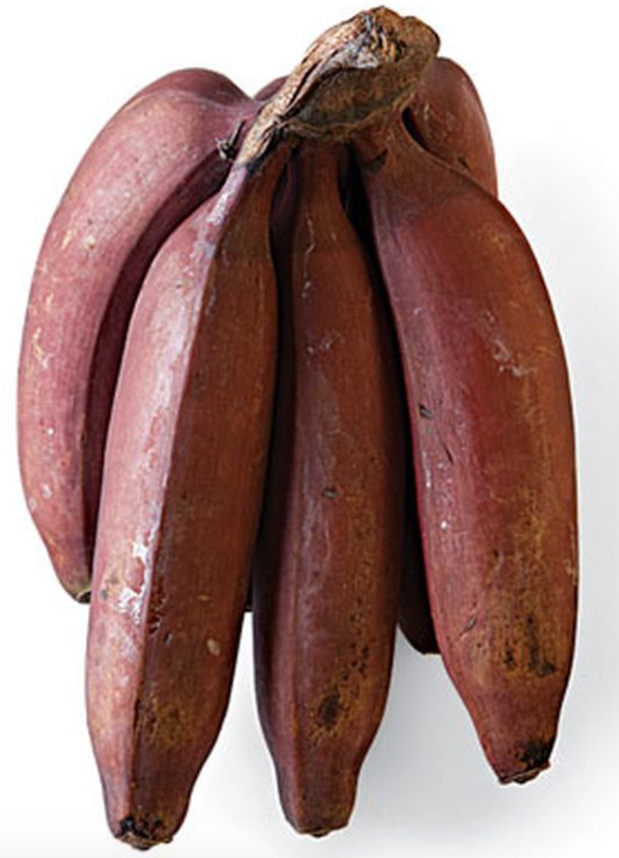
Representative Training Data
Banana
NOT Banana

Slide 17
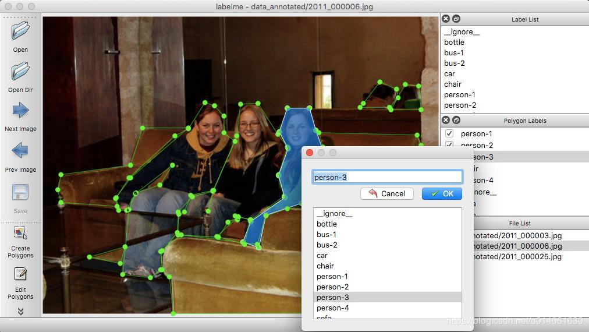
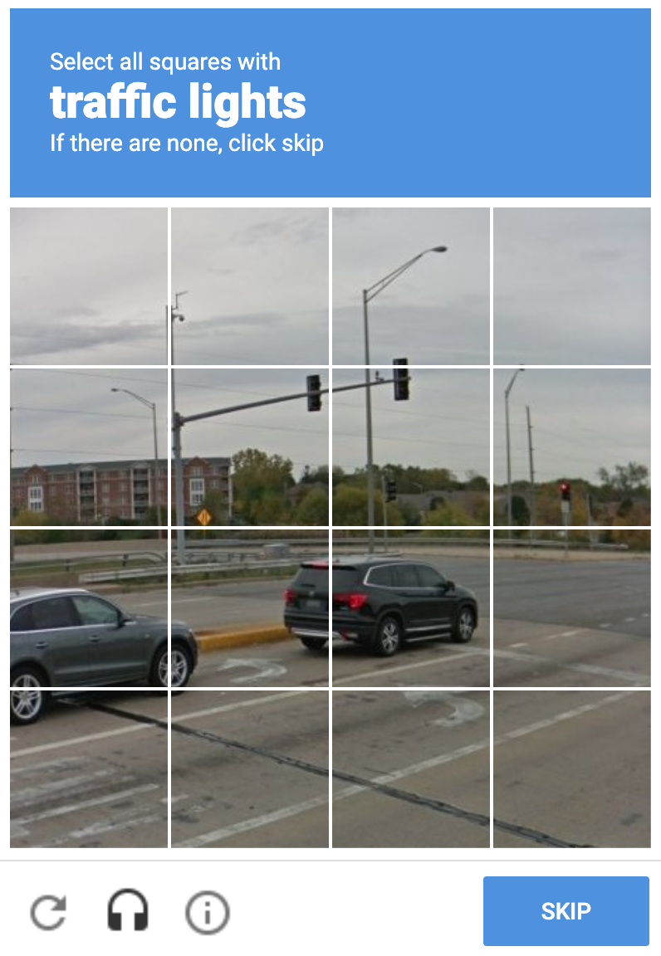

Step 2: Label Data
https://github.com/wkentaro/labelme

Slide 18
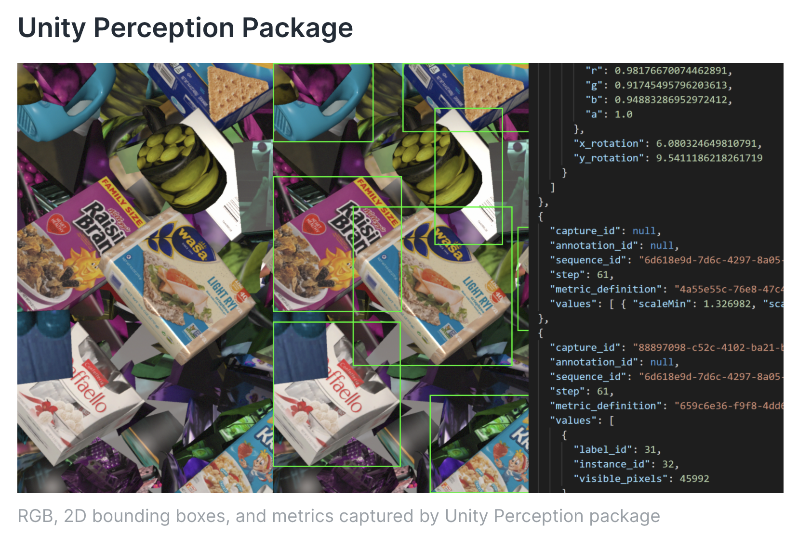
Generate Synthetic Labeled Data
https://blogs.unity3d.com/2020/06/10/use-unitys-computer-vision-tools-to-generate-and-analyze-synthetic-data-at-scale-to-train-your-ml-models/

Slide 19
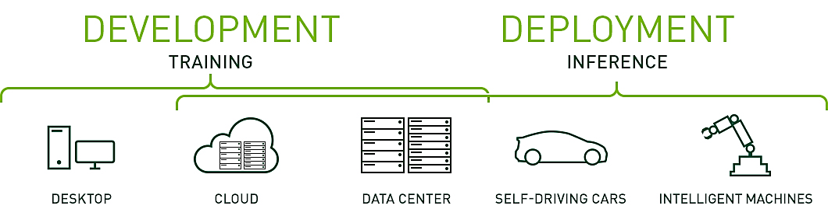



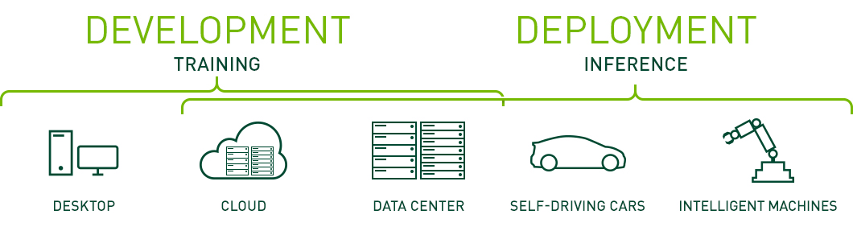
Step 3: Training a ML Model

Slide 20

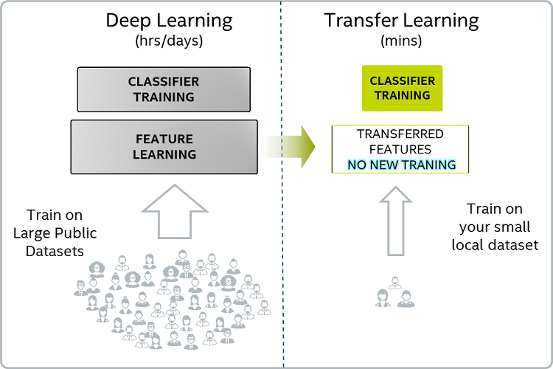
Transfer Learning
https://github.com/facebookresearch/detectron2/blob/master/MODEL_ZOO.md

Slide 21
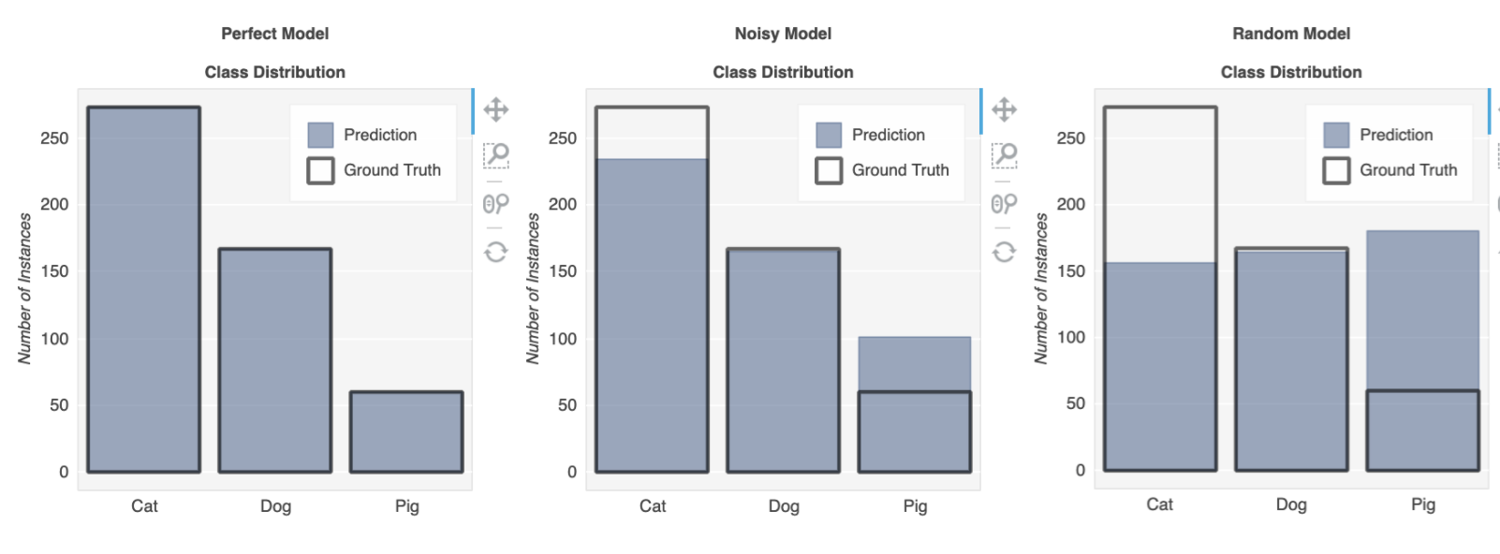
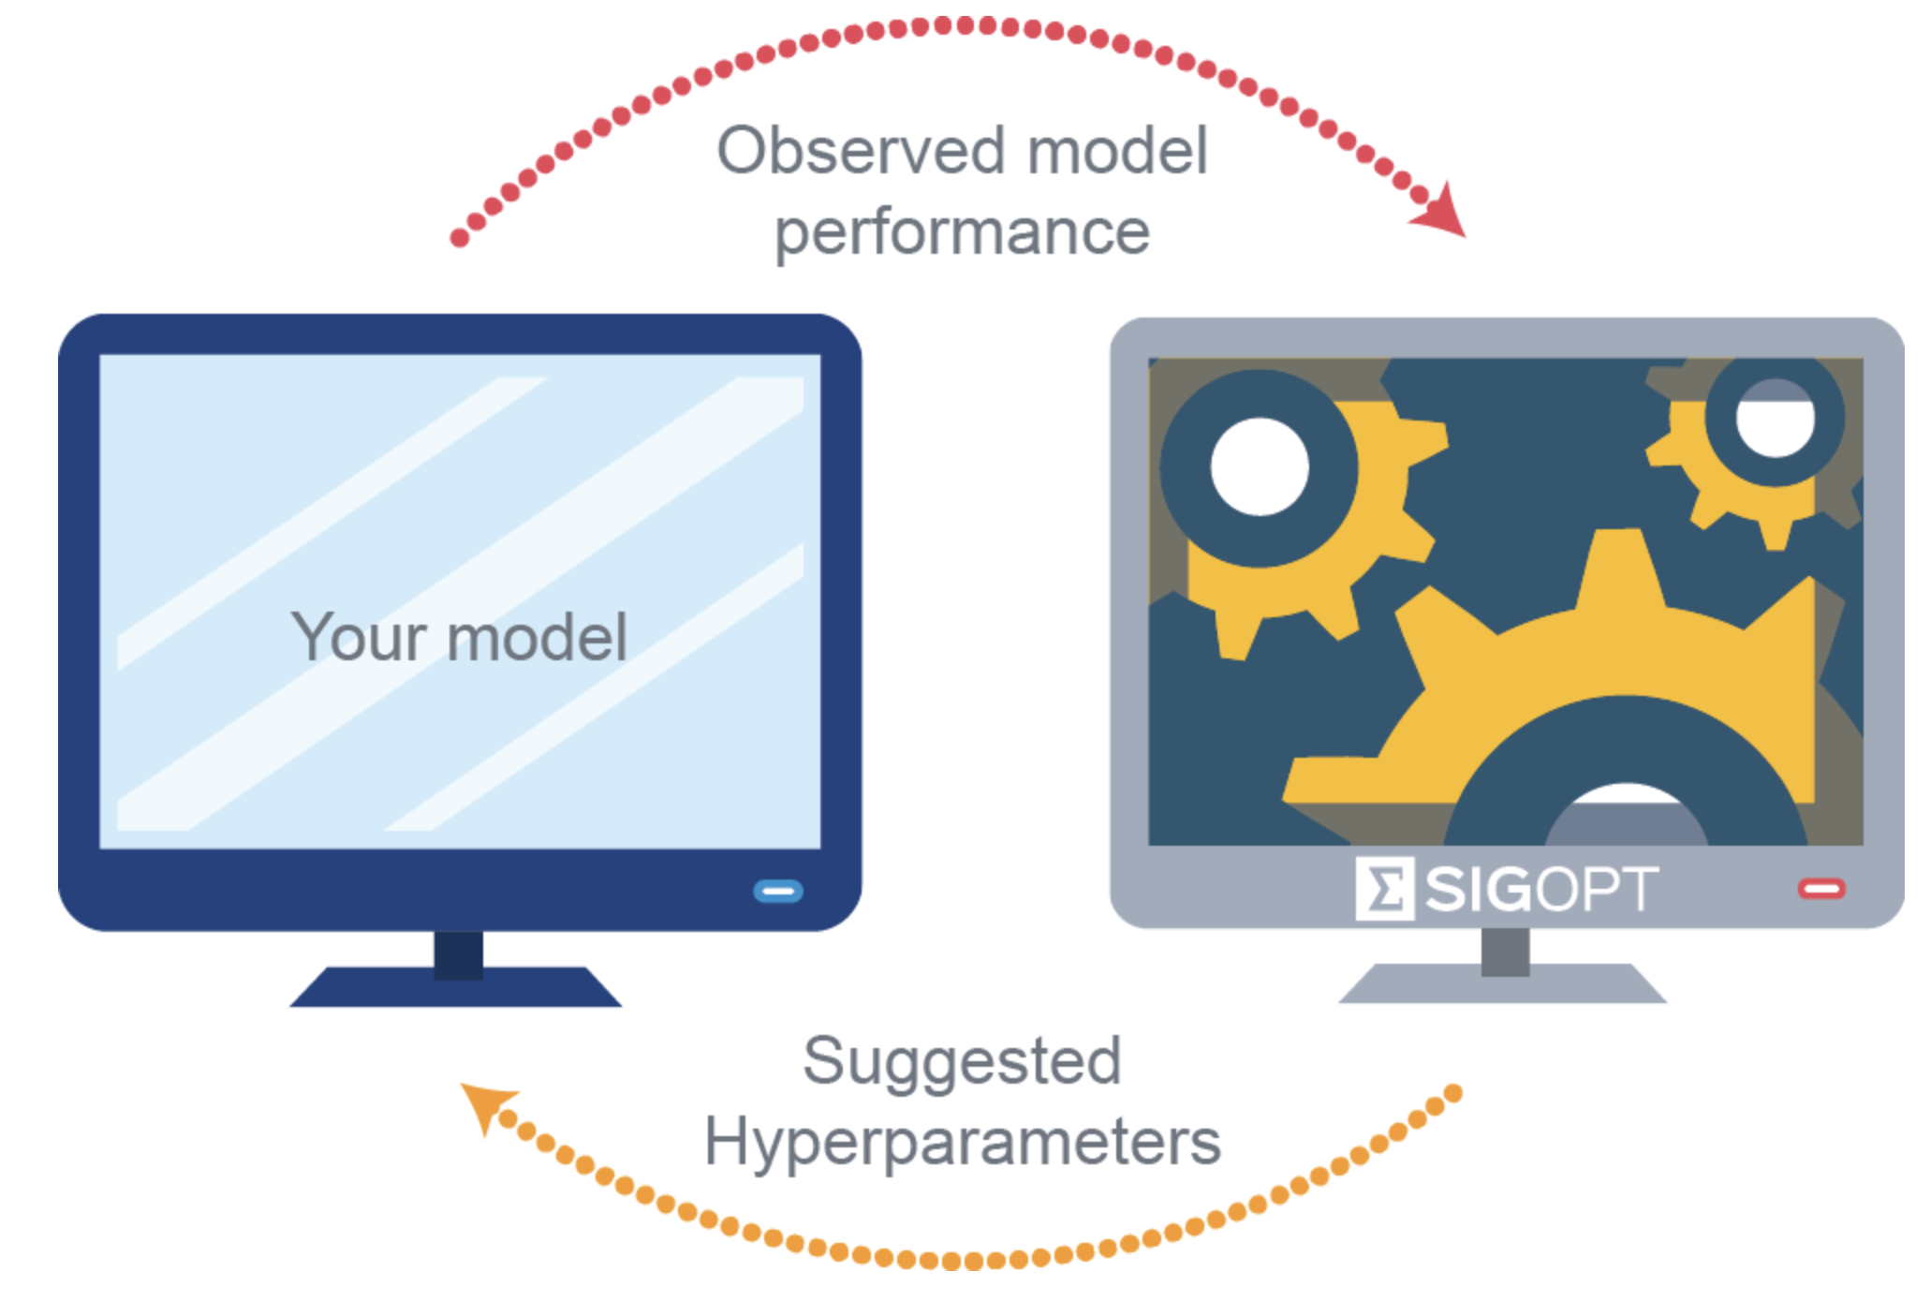

Step 4: Model Evaluation
https://sigopt.com/blog/common-problems-in-hyperparameter-optimization/

Slide 22


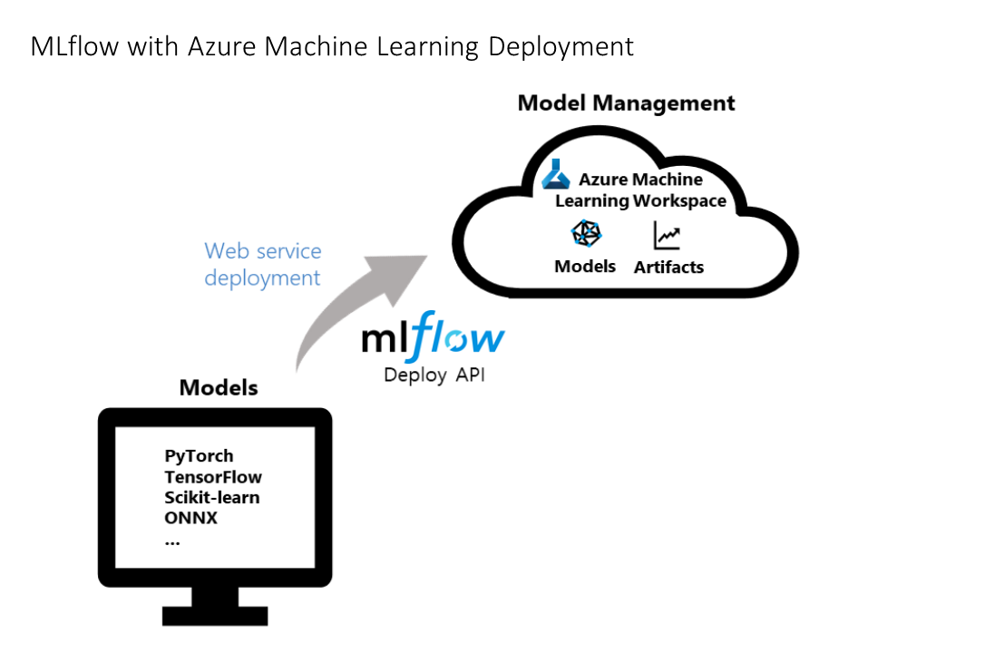

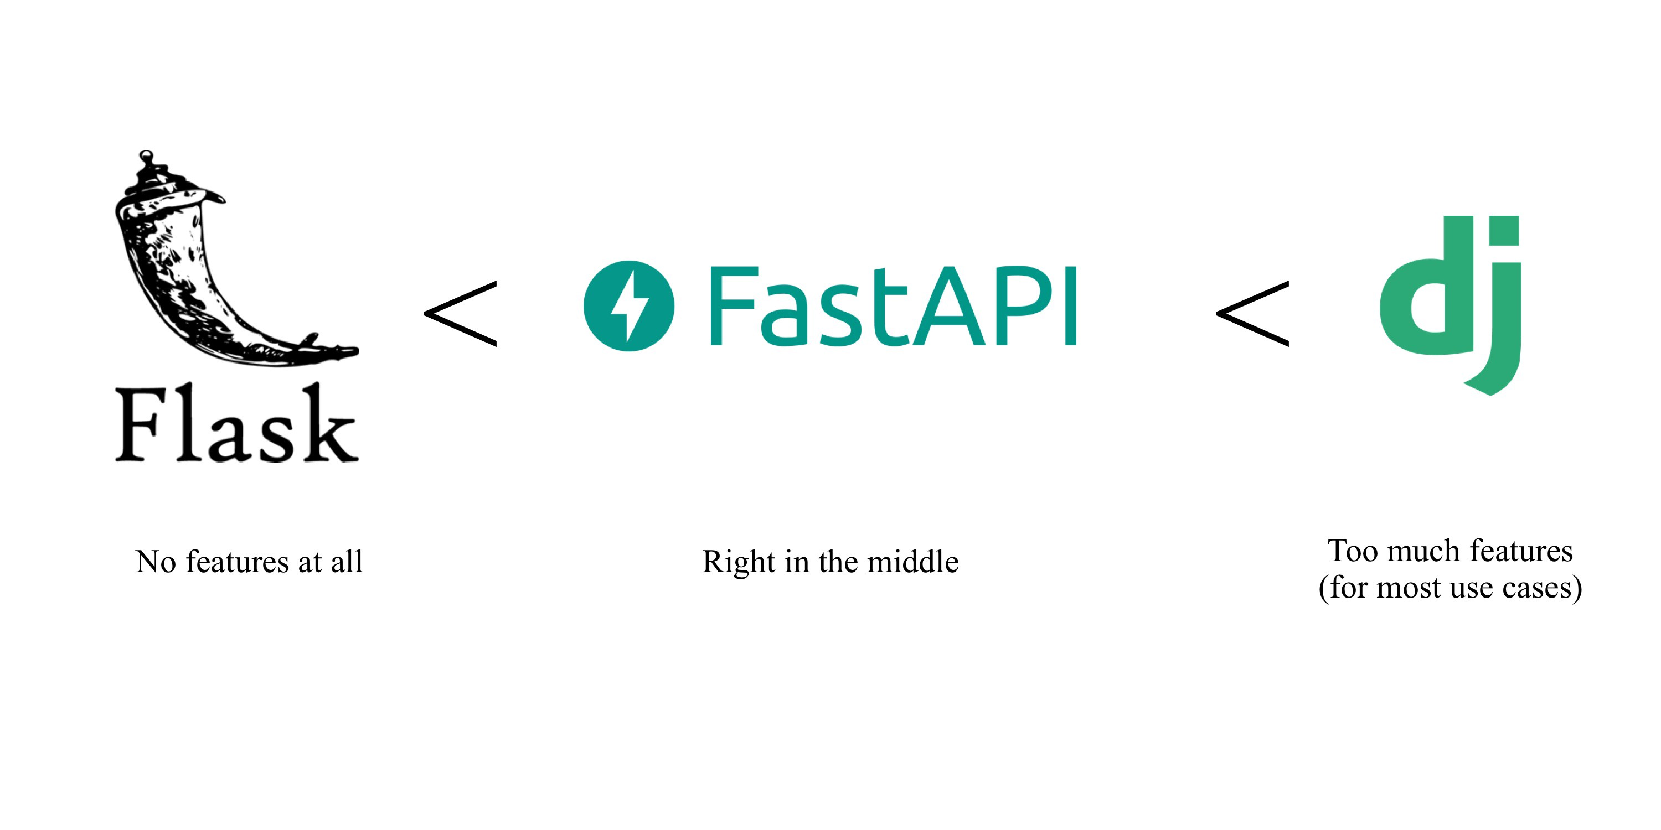


Step 5: Deployment & Hosting
Sagemaker
EC2

Slide 23
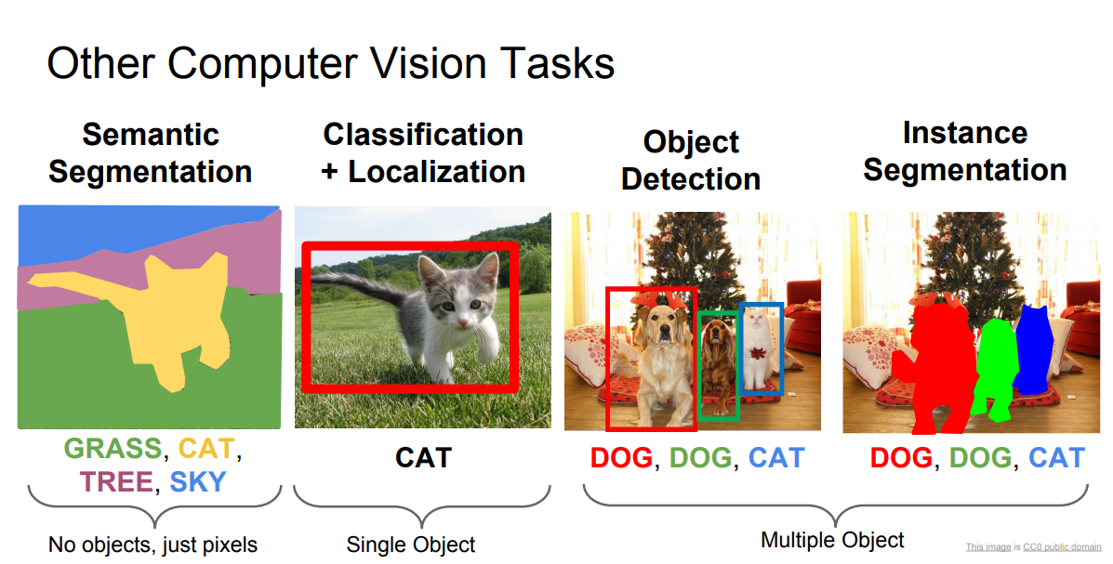
Types of Computer Vision Applications

Slide 24
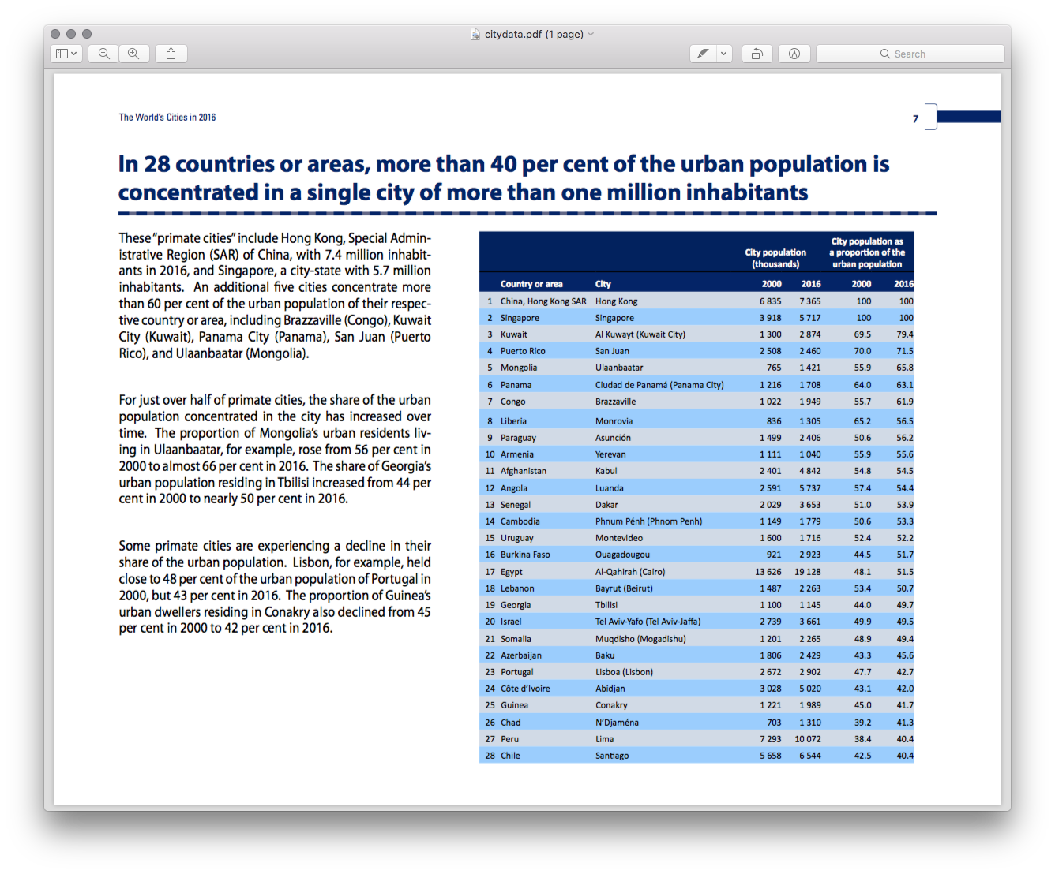
Use Cases – Object Detection
Table Detection in Scanned PDFs
Visual Recognition Systems

Slide 25
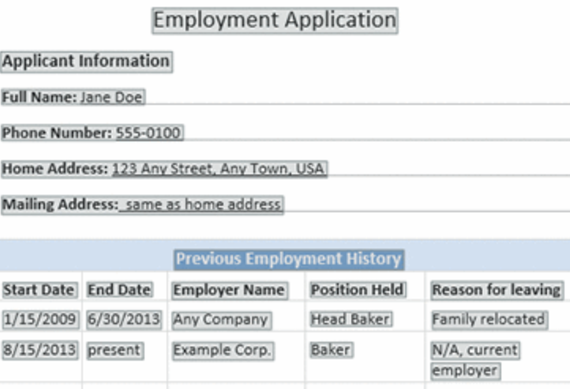
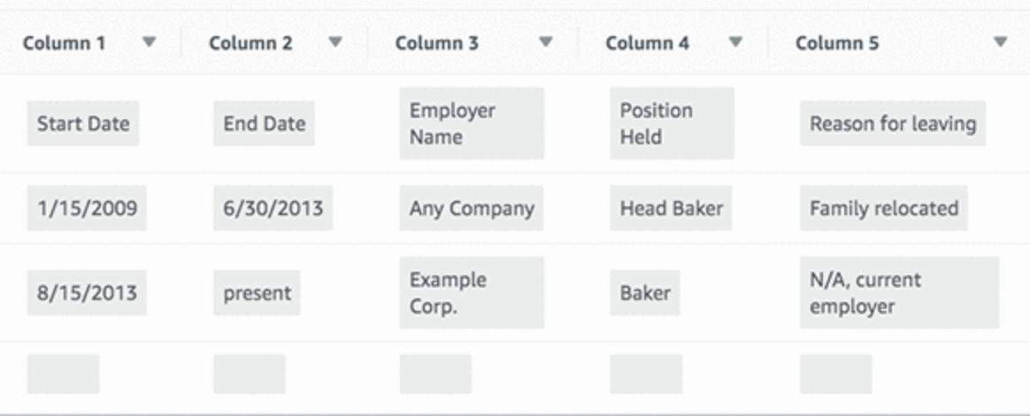
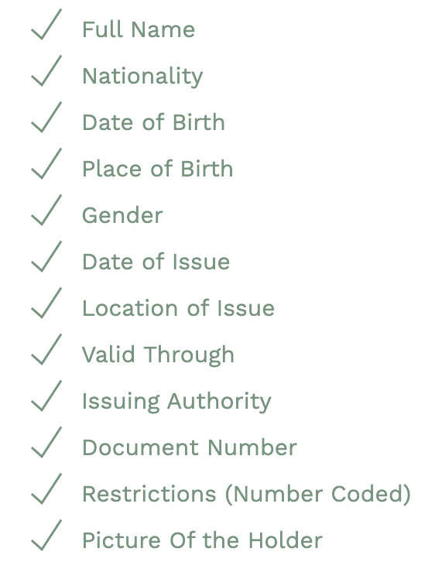
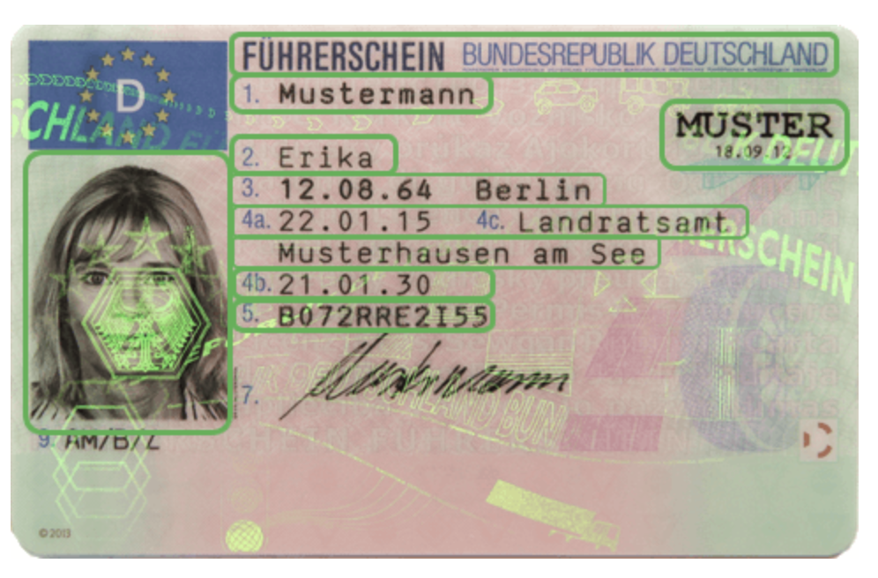
Use Cases – Text Extraction

Slide 26
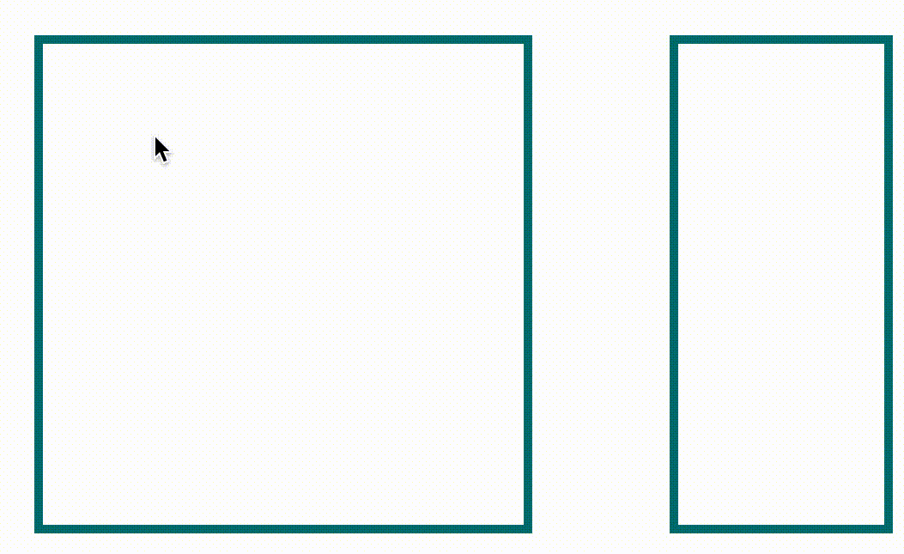
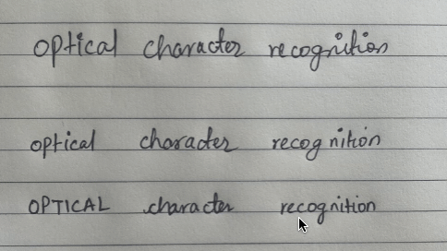
Recognizing Handwriting
https://github.com/githubharald/SimpleHTR

Slide 27
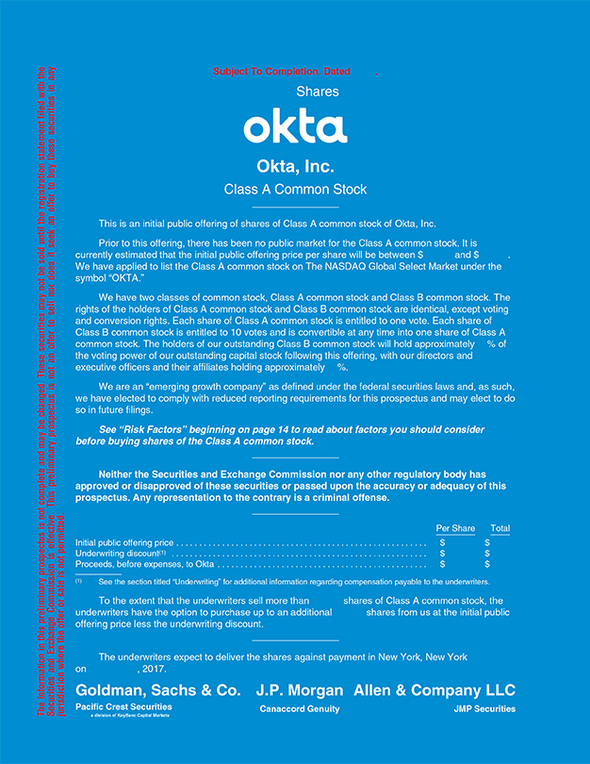
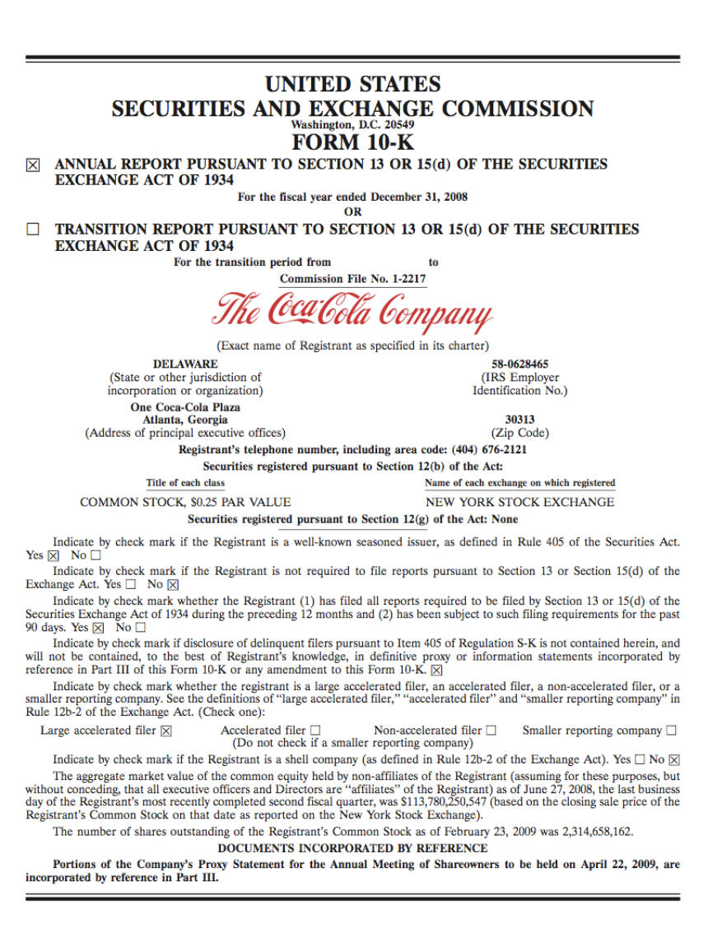
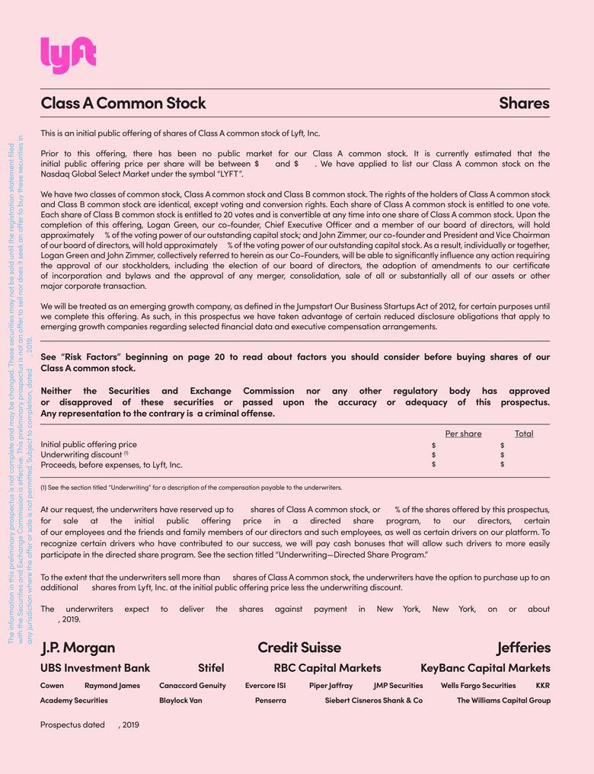
Image Classification
Common Stock Form
Form 10K
Common Stock Form

Slide 28
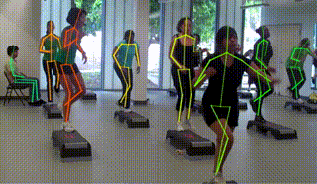
Pose Estimation
https://colab.research.google.com/github/tugstugi/dl-colab-notebooks/blob/master/notebooks/OpenPose.ipynb

Slide 29
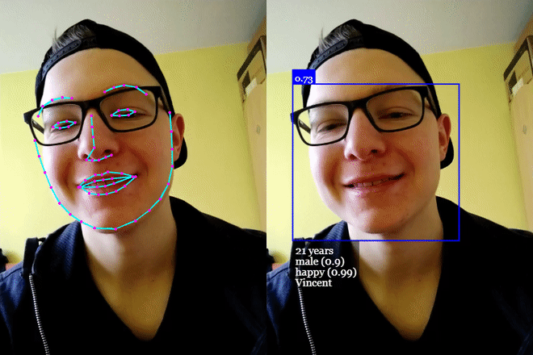
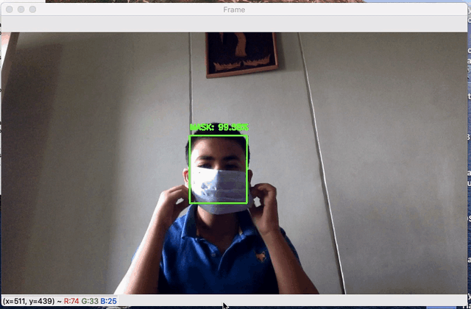
Facial & Mood Recognition
https://github.com/ageitgey/face_recognition

Slide 30

Speed Estimation & Object Tracking

Slide 31





Pix2Pix Generative Adversarial Network (GAN)
https://machinelearningmastery.com/how-to-develop-a-pix2pix-gan-for-image-to-image-translation/

Slide 32


Image Resolution Enhancement/Upscaling
https://idealo.github.io/image-super-resolution/
https://github.com/alexjc/neural-enhance

Slide 33


Synthetic Image Generation
Text Prompt: An armchair in the shape of an avocado
https://compvis.github.io/taming-transformers/
https://openai.com/blog/dall-e/
Notes:
DALL·E --- OpenAI: The neural network called DALL·E creates images from text captions

Slide 34


Research Applications
https://www.nature.com/articles/s41377-019-0129-y

Slide 35


Healthcare Applications
DeepMind’s Machine Learning Algorithm is capable of surpassing human doctors and radiology experts in lung cancer prediction.
The AI achieved 5.7% /1.2% (USA / UK) less false positives and 9.4% / 2.7% less false negatives across more than 30,000 samples.
DeepMind’s Neural Networks were also more accurate than six independent radiologists by an absolute margin of 11.5% in detecting breast cancer.
https://www.nature.com/articles/s41586-019-1799-6
https://msystems.asm.org/content/5/1/e00840-19
http://biostat.mc.vanderbilt.edu/wiki/pub/Main/CourseDSI5640/ai_mammography.pdf

Slide 36

CV + NLP = Automated Graph Summarization
Type of Chart: horizontal bar
X Axis: Favorite Movie Genre
Y Axis: Number of People (X 100)
The horizontal bar graph depicts 'Favorite Genre of Movie'. The graph is plot between 'Number of people (X 100)' x-axis over 'Movie Genres' y-axis. The Number of people (X 100) for the corresponding Movie Genres are Action = 1896, Comedy = 3187, Crime = 2393, Romance = 1300, Scifi = 3187. (All Values estimated)
Robotic Process Automation?
https://arxiv.org/pdf/1812.10636.pdf

Slide 37


NLP + CV + Hand drawn Images = Website
https://www.microsoft.com/en-us/ai/ai-lab-sketch2code

Slide 38



Computer Vision Going Mobile
https://www.tomshardware.com/news/raspberry-pi-cat-detecting-gun
https://ai.facebook.com/blog/d2go-brings-detectron2-to-mobile/
https://arxiv.org/abs/2009.05697

Slide 39


SEER – Facebook AI Research
SEER - a new billion-parameter self-supervised computer vision model that can learn from any random group of images on the internet
https://vissl.ai/
https://ai.facebook.com/blog/seer-the-start-of-a-more-powerful-flexible-and-accessible-era-for-computer-vision/

Slide 40

CLIP - Contrastive Language–Image Pre-training
https://openai.com/blog/clip/

Slide 41

Things To Keep In Mind
Benefits:
1) Fast, Accurate, & Low Cost
2) Pretrained Open-Source Models
3) Bring Your Own Data & Labels
4) Numerous Application Areas
Drawbacks:
1) Cost of Datasets, Labels & Training
2) Narrow Real-World Performance
3) Data Drift & Monitoring Requirements
4) Privacy Concerns
https://openai.com/blog/clip/

Slide 42

Thank You For Attending!
Moores Law: https://medium.com/predict/moores-law-is-alive-and-well-eaa49a450188
OpenAI ML Change --- https://openai.com/blog/ai-and-compute
Detectron2 –https://colab.research.google.com/drive/16jcaJoc6bCFAQ96jDe2HwtXj7BMD_-m5
DEIT --- https://colab.research.google.com/github/facebookresearch/deit/blob/colab/notebooks/deit_inference.ipynb
Pose Detection --- https://colab.research.google.com/github/tugstugi/dl-colab-notebooks/blob/master/notebooks/OpenPose.ipynb
FastAI – Rapidly train new vision model --- https://docs.fast.ai/tutorial.vision.html
List of other CV Notebooks --- https://www.qblocks.cloud/creators/computer-vision-google-colab-notebooks
Google AI Research Updates --- https://ai.googleblog.com/
Facebook Research Updates --- https://ai.facebook.com/
https://ai.facebook.com/blog/self-supervised-learning-the-dark-matter-of-intelligence/
https://github.com/facebookresearch/vissl
https://petapixel.com/2021/03/04/facebooks-seer-ai-has-trained-itself-to-recognize-objects/

